Slide 1
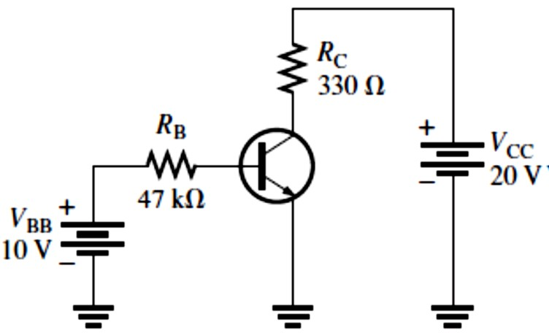
Lecture 5: Transistor Bias Circuits
5.1 The DC Operating Point
The purpose of biasing a circuit is to establish a proper stable dc operating point or quiescent point (Q-point).
The Q-point of a circuit is defined by specific values for 𝐼_{C} and �_{CE}. These values are called the coordinates of the Q-point.
Improper biasing can cause distortion in the output signal,
limiting of the positive portion of ���� as a result of a Q-point being too close to cutoff.
limiting of the negative portion of ���� as a result of a Q-point being too close to saturation.
A dc load line passes through the Q-point on a transistor’s collector curves intersecting the vertical axis at approximately 𝐼_{C(sat)} and the horizontal axis at �_{CE(off)}.
The linear (active) operating region of a transistor lies along the load line below saturation and above cutoff.
EXAMPLE 5-1: Determine the Q-point for the circuit in Figure 5-1 and draw the dc load line. Find the maximum peak value of base current for linear operation. Assume 𝛽_{DC} = 200.
FIGURE 5-1
Solution The Q-point is defined by the values of 𝐼_{C} and �_{CE}.
𝐼_{B} =
�BB ^{− �}BE
10 V − 0.7 V
𝑅
= = 198 𝜇A
B
47 kΩ
𝐼_{C} = 𝛽_{DC}𝐼_{B} = (200)(198 𝜇A) = 39.6 mA
�_{CE} = �_{CC} − 𝐼_{C}𝑅_{C} = 20 V − (39.6 mA)(330 Ω) = 10 V − 13.07 V = 6.93 V
The Q-point is at 𝐼_{C} = 39.6 mA and at �_{CE} = 6.93 V.
Since 𝐼_{C(cutoff)} = 0, we need to know 𝐼_{C(sat)} to determine how much variation in collector current
can occur and still maintain linear operation of the transistor.
�CC
20 V
= = 60.6 mA 330 Ω
^{𝐼}C(sat) ⁼ _{𝑅}
C
The dc load line is graphically illustrated in Figure 5-2, showing that before saturation is reached,
𝐼_{C} can increase an amount ideally equal to
𝐼_{C(sat)} − 𝐼_{CQ} = 60.6 mA − 39.6 mA = 21.0 mA
However, 𝐼_{C} can decrease by 39.6 mA before cutoff (𝐼_{C} = 0) is reached. Therefore, the limiting excursion is 21 mA because the Q-point is closer to saturation than to cutoff. The 21 mA is the

Slide 2
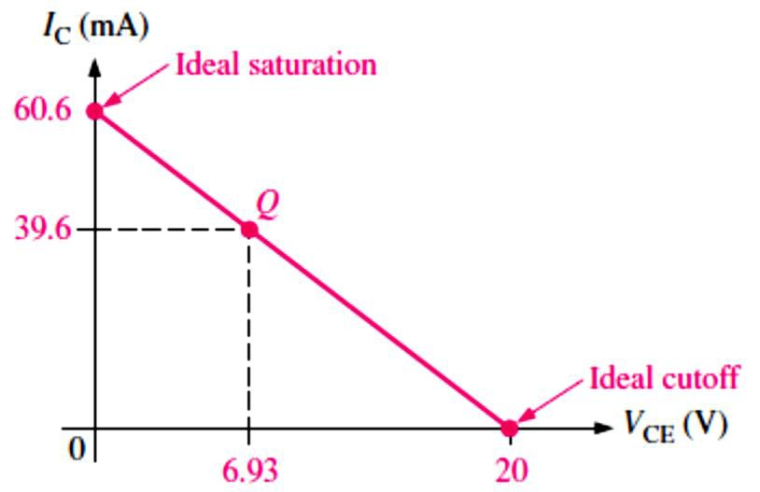
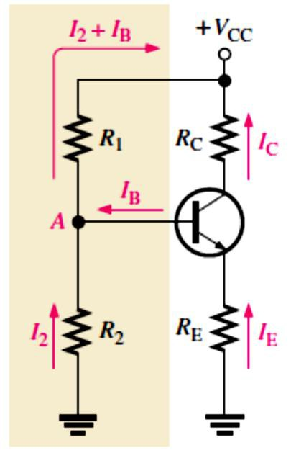
maximum peak variation of the collector current. Actually, it would be slightly less in practice because �_{CE(sat)} is not quite zero.
FIGURE 5-2
We determine the maximum peak variation of the base current as follows:
^{𝐼}�(�𝑒�𝑘)
21 mA
^{𝐼}�(�𝑒�𝑘) ⁼
𝛽
= = 105 𝜇A
DC
200
5.2 Voltage-Divider Bias
This is the most widely used biasing method of biasing a transistor for linear operation of using a single-source resistive voltage divider, as shown in Figure 5-3.
A voltage divider in which the base current is small compared to the current in 𝑅₂ is said to be a stiff voltage divider because the base voltage is relatively independent of different transistors and temperature effects.
Loading effects are neglected for a stiff voltage divider.
The dc input resistance at the base of a BJT is approximately 𝛽_{DC}𝑅_{E}.
Voltage-divider bias provides good Q-point stability with a single-polarity supply voltage. It is the most common bias circuit.
FIGURE 5-3: Voltage-divider bias.
To analyze a voltage-divider circuit in which 𝐼_{B} is small compared to 𝐼₂, first we calculate the voltage on the base using the unloaded voltage-divider rule:
𝑽� ≅ (_{𝑹}
𝑹�
Equation 5– 1
_{+ 𝑹}^{) 𝑽}��
� �
Once we know the base voltage, we can find the voltages and currents in the circuit, as follows:

Slide 3
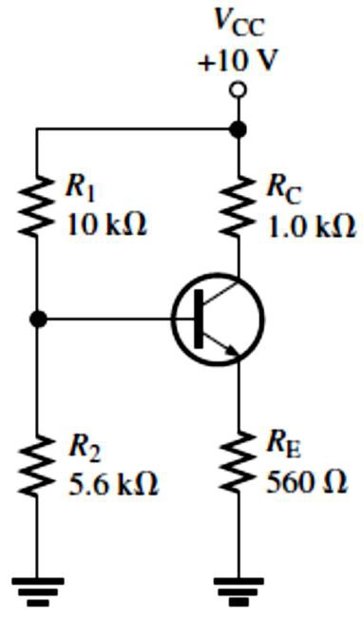
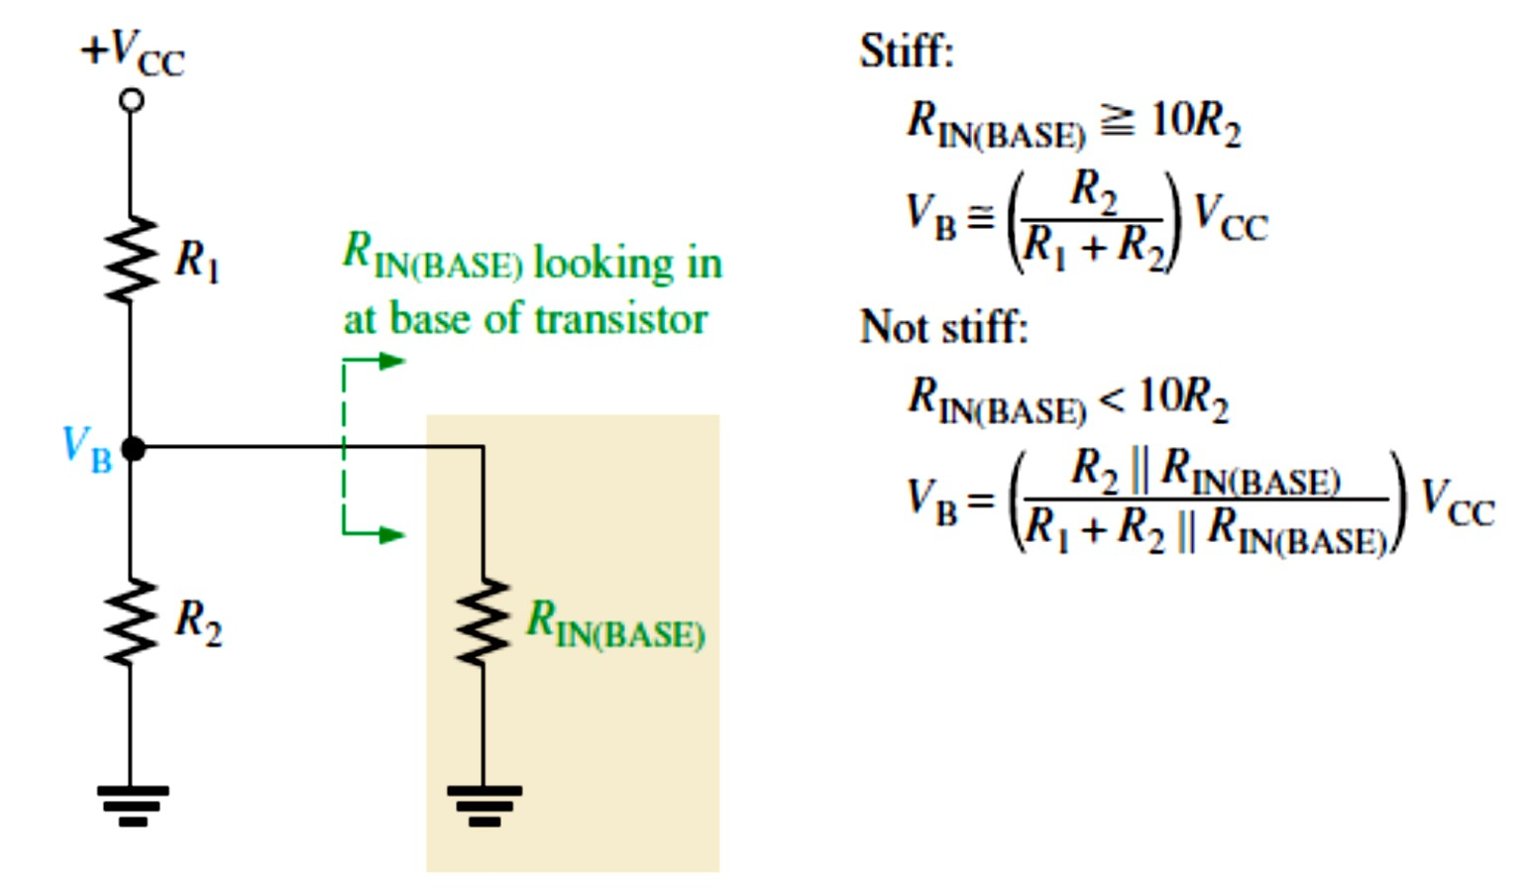
𝑽� = 𝑽� − 𝑽��
Equation 5– 2
and
𝑽�
𝑰� ≅ 𝑰� = _{𝑹}
Equation 5– 3
Equation 5– 4
Then,
�
𝑽� = 𝑽�� − 𝑰�𝑹�
Once we know �_{C} and �_{E}, we can determine �_{CE}.
�_{CE} = �_{C} − �_{E}
EXAMPLE 5-2: Determine �_{CE} and 𝐼_{C} in the stiff voltage-divider biased transistor circuit of Figure 5-4 if 𝛽_{DC} = 100.
FIGURE 5-4
Solution The base voltage is
�_{B} ≅ (_{𝑅}
𝑅₂
5.6 kΩ
) 10 V = 3.59 V
+ 𝑅^{) �CC = (}10 kΩ + 5.6 kΩ
1 2
So, �_{E} = �_{B} − �_{BE} = 3.59 V − 0.7 V = 2.89 V
And
�_{E} 2.89 V
𝐼_{E} = _{𝑅}= _{560 Ω} = 5.16 mA
E
Therefore, 𝐼_{C} ≅ 𝐼_{E} = 5.16 mA
And �_{C} = �_{CC} − 𝐼_{C}𝑅_{C} = 10 V − (5.16 mA)(1.0 kΩ) = 4.84 V
�_{CE} = �_{C} − �_{E} = 4.84 V − 2.89 V = 1.95 V
To determine if the divider is stiff, we need to examine the dc input resistance looking in at the base as shown in Figure 5-5.
FIGURE 5-5: Voltage divider with load.

Slide 4
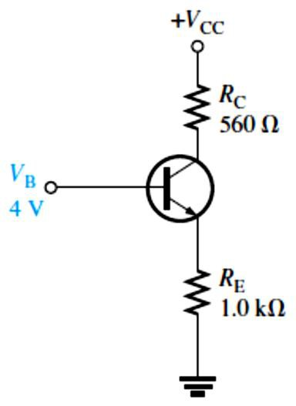
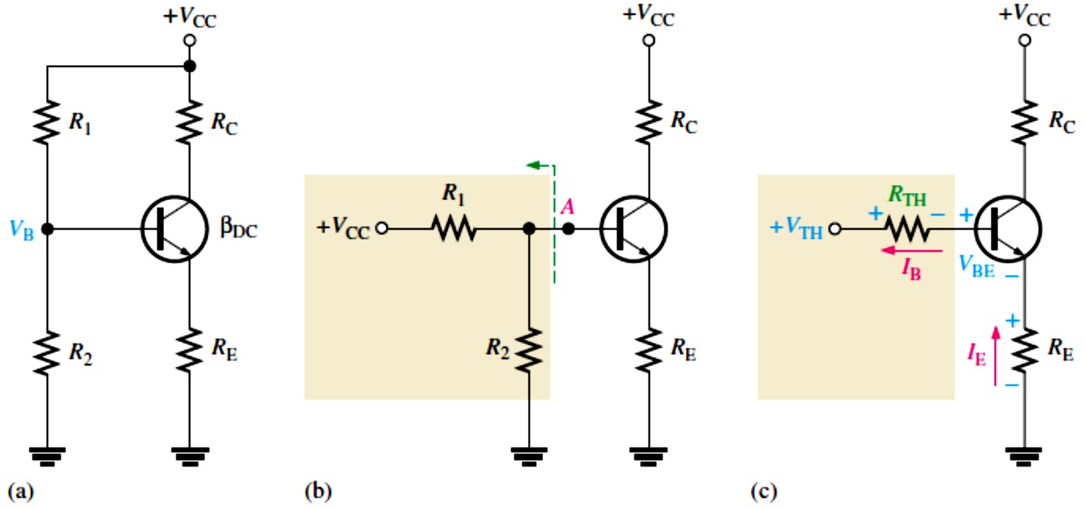
Loading Effects of Voltage-Divider Bias: DC Input Resistance at the Transistor Base is proportional to 𝛽_{DC} so it will change for different transistors.
^{𝑹}��(����) ⁼
^{𝜷}��^{𝑽}�
Equation 5– 5
𝑰
�
This is the effective load on the voltage divider illustrated in Figure 5-5.
We can quickly estimate the loading effect: If 𝑹_{��(����)} is at least ten times larger than
𝑹�, the loading effect will be 10% or less and the voltage divider is stiff. If 𝑹_{��(����)} is less than ten times 𝑹�, it should be combined in parallel with 𝑹�.
EXAMPLE 5-3: Determine the dc input resistance looking in at the base of the transistor in Figure 5-6. 𝛽_{DC} = 125 and �_{B} = 4 V.
Solution
�_{BE} = �_{B} − �_{E}
0.7 V = �_{B} − 𝐼_{E}𝑅_{E}
FIGURE 5-6
𝐼_{E} =
�_{B} − 0.7 V
=
4 V − 0.7 V
= 3.3 mA
𝑅
E
1.0 kΩ
^{𝛽}DC�B
125 (4 V)
^{𝑅}IN(BASE) ⁼
𝐼
= = 152 kΩ
E
3.3 mA
Thevenin’s Theorem Applied to Voltage-Divider Bias: To analyze a voltage-divider biased transistor circuit for base current loading effects, we will apply Thevenin’s theorem to evaluate the circuit. First, let’s get an equivalent base-emitter circuit for the circuit in Figure 5-6(a) using Thevenin’s theorem. Looking out from the base terminal, the bias circuit can be redrawn as shown in Figure 5-6(b).
𝑰� = _{𝑹}
^{𝑽}�� ^{− 𝑽}��
Equation 5– 6
�
+ 𝑹⁄𝜷
�� ��
FIGURE 5-6: Thevenizing the bias circuit.

Slide 5
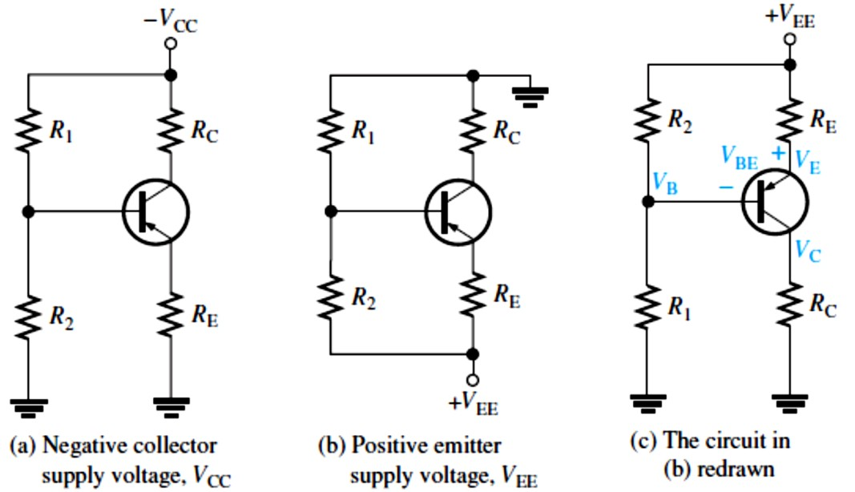
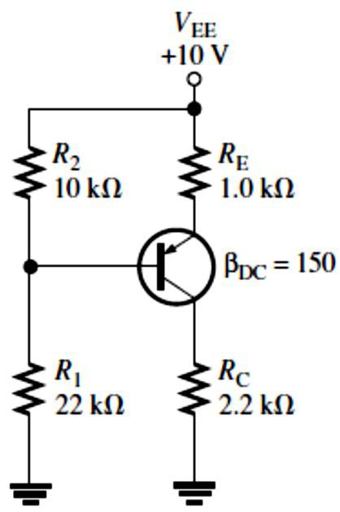
If 𝑅_{TH}⁄𝛽_{DC} is small compared to 𝑅_{E}, the result is the same as for an unloaded voltage divider.
Voltage-divider bias is widely used because reasonably good bias stability is achieved with a single supply voltage.
Voltage-Divider Biased PNP Transistor requires bias polarities opposite to the npn. This can
be accomplished with a negative collector supply voltage, as in Figure 5-7(a), or with a positive emitter supply voltage, as in Figure 5-7(b).
FIGURE 5-7: Voltage-divider biased pnp transistor.
In a schematic, the pnp is often drawn upside down so that the supply voltage is at the top of the schematic and ground at the bottom, as in Figure 5-7(c).
The analysis procedure is the same as for an npn transistor circuit using Thevenin’s theorem and Kirchhoff’s voltage law: For Figure 5-7(a), the equation for 𝐼_{E} is
𝑰� = _{𝑹}
−𝑽�� + 𝑽��
Equation 5– 7
+ 𝑹⁄𝜷
� �� ��
For Figure 5-7(b), The equation for 𝐼_{E} is
𝑰� =
^{𝑽}�� ^{+ 𝑽}�� ^{− �}EE
Equation 5– 8
^{𝑹}� ^{+ 𝑹}��^{⁄𝜷}��
EXAMPLE 5-4: Find 𝐼_{C} and �_{EC} for the pnp transistor circuit in Figure 5-8.
FIGURE 5-8
Solution This circuit has the configuration of Figures 5-7(b) and (c). Apply Thevenin’s theorem.
�_{TH} = (_{𝑅}
𝑅₁
22 kΩ
+ 𝑅^{) �EE = (}22 kΩ + 10 kΩ ^{) 10 V}
1 2
�_{TH} = (0.688)10 V = 6.88 V
𝑅_{TH} = _{𝑅}
𝑅₁𝑅₂
(22 kΩ)(10 kΩ)
= = 6.88 kΩ
+ 𝑅22 kΩ + 10 kΩ
1 2
Use Equation 5–8 to determine 𝐼_{E}.

Slide 6
𝐼_{E} =
�TH ^{+ �}BE ^{− �}EE
6.88 V + 0.7 V − 10 V −2.42 V
𝑅+ 𝑅⁄𝛽⁼ 1.0 kΩ + 6.88 kΩ⁄150 ⁼ 1.0 kΩ + 45.9 Ω ^{= −2.31 mA}
E TH DC
The negative sign on 𝐼_{E} indicates that the assumed current direction in the Kirchhoff’s analysis is opposite from the actual current direction. From 𝐼_{E}, we can determine 𝐼_{C} and �_{EC} as follows:
𝐼_{C} = 𝐼_{E} = 2.31 mA
�_{C} = 𝐼_{C}𝑅_{C} = (2.31 mA)(2.2 kΩ) = 5.08 V
�_{E} = �_{EE} − �_{𝑅E} = �_{EE} − 𝐼_{E}𝑅_{E} = 10 V − (2.31 mA)(1.0 kΩ) = 7.68 V
�_{EC} = �_{E} − �_{C} = 7.68 V − 5.08 V = 2.6 V
EXAMPLE 5-5: Find 𝐼_{C} and �_{CE} for a pnp transistor circuit with these values:𝑅₁ = 68 kΩ, 𝑅₂ = 47 kΩ, 𝑅_{C} = 1.8 kΩ, 𝑅_{E} = 2.2 kΩ, �_{CC} = −6 V, and 𝛽_{DC} = 75. Refer to Figure 5-7(a), which shows the schematic with a negative supply voltage.
Solution Apply Thevenin’s theorem.
�_{TH} = (_{𝑅}
𝑅₂
47 kΩ
) (−6 V) = (0.409)(−6 V) = −2.45 V
1
+ 𝑅^{) �CC = (}68 kΩ + 47 kΩ
2
𝑅₁𝑅₂
(68 kΩ)(47 kΩ)
𝑅_{TH} = _{𝑅}
+ 𝑅⁼ 68 kΩ + 47 kΩ ^{= 27.8 kΩ}
Use Equation 5–7 to determine 𝐼_{E}.
1 2
𝐼_{E} = _{𝑅}
−�_{TH} + �_{BE}
−(−2.45 V) + 0.7 V 3.15 V
+ 𝑅⁄𝛽
⁼ 2.2 kΩ + 27.8 kΩ⁄75 ⁼ 2.2 kΩ + 371 Ω ^{= 1.23 mA}
E TH DC
From 𝐼_{E}, we can determine 𝐼_{C} and �_{CE} as follows:
𝐼_{C} = 𝐼_{E} = 1.23 mA
�_{C} = −�_{CC} − �_{𝑅C} = −�_{CC} + 𝐼_{C}𝑅_{C} = −6 V + (1.23 mA)(1.8 kΩ) = −3.79 V
�_{E} = �_{EE} − �_{𝑅E} = �_{EE} − 𝐼_{E}𝑅_{E} = 0 − (1.23 mA)(2.2 kΩ) = −2.71 V
�_{CE} = �_{C} − �_{E} = −3.79 V − (−2.71 V) = −1.08 V
5.3 Other Bias Methods
In this section, four additional methods for dc biasing a transistor circuit are discussed.
Emitter Bias: provides excellent bias stability in spite of changes in 𝛽or temperature but requires both positive and negative supply voltages.
To obtain a reasonable estimate of the key dc values in an emitter-biased circuit, analysis is quite easy. In an npn circuit, such as shown in Figure 5-9, we can obtain the 𝐼_{E} as
𝑰� = _{𝑹}
−𝑽�� − 𝑽��
Equation 5– 9
�
+ 𝑹⁄𝜷
� ��
�_{E} = �_{EE} + �_{𝑅E} = �_{EE} + 𝐼_{E}𝑅_{E}
�_{B} = �_{E} + �_{BE}
�_{C} = �_{CC} − �_{𝑅C} = �_{CC} − 𝐼_{C}𝑅_{C}

Slide 7
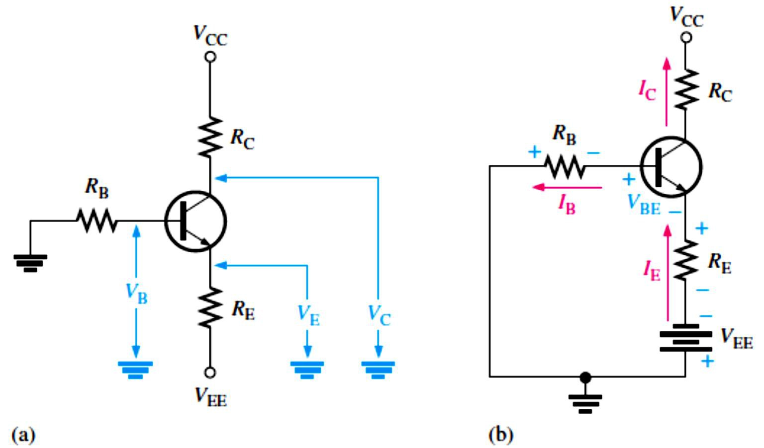
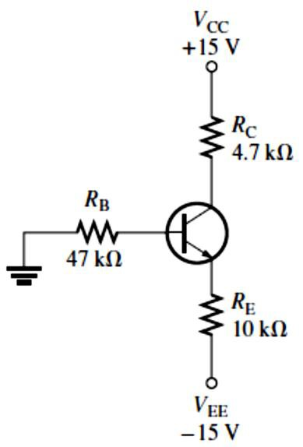
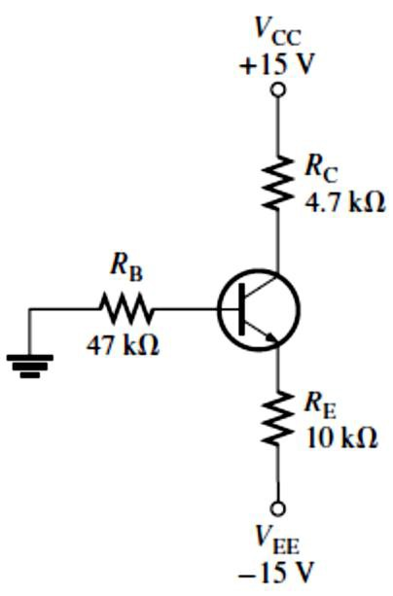
FIGURE 5-9: An npn transistor with emitter bias. Polarities are reversed for a pnp transistor. Single subscripts indicate voltages with respect to ground.
EXAMPLE 5-6: Calculate 𝐼_{E} and �_{CE} for the circuit in Figure 5-10 using the approximations
�_{E} ≅ −1 V and 𝐼_{C} ≅ 𝐼_{E}.
FIGURE 5-10
Solution
�_{E} ≅ −1 V
𝐼_{E} =
−�_{EE} − 1 V
=
−(−15 V) − 1 V
14 V
= _{10 kΩ} = 1.4 mA
𝑅
E
10 kΩ
�_{C} = �_{CC} − �_{𝑅C} = �_{CC} − 𝐼_{C}𝑅_{C} = +15 V − (1.4 mA)(4.7 kΩ) = 8.4 V
�_{CE} = �_{C} − �_{E} = 8.4 V − (−1 V) = 9.4 V
EXAMPLE 5-7: Determine how much the Q-point (𝐼_{C}, �_{CE}) for the circuit in Figure 5-11 will change if 𝛽_{DC} increases from 100 to 200 when one transistor is replaced by another.
FIGURE 5-11
Solution For 𝛽_{DC} = 100,
^{𝐼}C(1) ^{≅ 𝐼}E ⁼ _{𝑅}
−�_{EE} − �_{BE}
−(−15V) − 0.7 V
+ 𝑅⁄𝛽⁼ 10 kΩ + 47 kΩ⁄100 ^{= 1.37 mA}
E B DC
�_{C} = �_{CC} − 𝐼_{C(1)}𝑅_{C} = 15 V − (1.37 mA)(4.7 kΩ) = 8.56 V
�_{E} = �_{EE} + 𝐼_{E}𝑅_{E} = −15 V + (1.37 mA)(10 kΩ) = −1.3 V
Therefore, �_{CE(1)} = �_{C} − �_{E} = 8.56 V − (−1.3) = 9.83 V
For 𝛽_{DC} = 200,

Slide 8
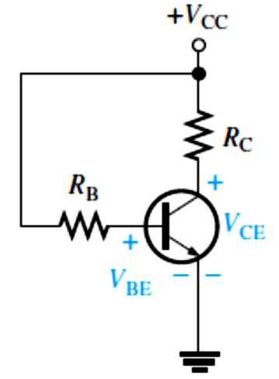
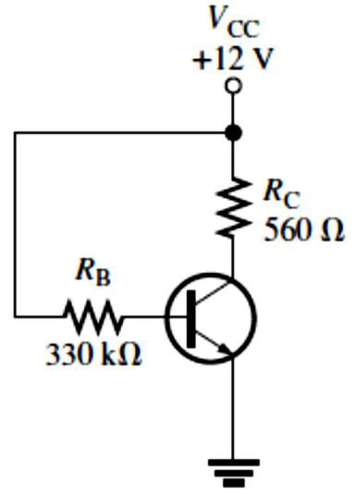
^{𝐼}C(2) ^{≅ 𝐼}E ⁼ _{𝑅}
−�_{EE} − �_{BE}
−(−15V) − 0.7 V
+ 𝑅⁄𝛽⁼ 10 kΩ + 47 kΩ⁄200 ^{= 1.38 mA}
E B DC
�_{C} = �_{CC} − 𝐼_{C(2)}𝑅_{C} = 15 V − (1.38 mA)(4.7 kΩ) = 8.51 V
�_{E} = �_{EE} + 𝐼_{E}𝑅_{E} = −15 V + (1.38 mA)(10 kΩ) = −1.2 V
Therefore, �_{CE(2)} = �_{C} − �_{E} = 8.51 V − (−1.2) = 9.71 V
The percent change in 𝐼_{C} as 𝛽_{DC} changes from 100 to 200 is
%∆𝐼_{C} = (
^{𝐼}C(2) ^{− 𝐼}C(1)
) 100% = (
1.38 mA − 1.37 mA
) 100% = 0.730%
𝐼
C(1)
1.37 mA
The percent change in �_{CE} is
�CE(2) ^{− �}CE(1)
%∆�_{CE} = (
9.71 V − 9.83 V
𝑉
) 100% = ( ) 100% = −1.22%
CE(1)
9.83 V
Base Bias: has poor stability because its Q-point varies widely with 𝛽_{DC}.
This method of biasing is common in switching circuits. Figure 5-12 shows a base-biased transistor. The analysis of this circuit for the linear region is directly dependent on 𝛽_{DC}.
𝑽�� = 𝑽�� − 𝑰�𝑹�
Equation 5– 10
Equation 5– 11
𝑰� = 𝜷�� (
^{𝑽}�� ^{− 𝑽}��
)
𝑹
�
FIGURE 5-12: Base bias.
EXAMPLE 5–8: Determine how much the Q-point (𝐼_{C}, �_{CE}) for the circuit in Figure 5-13 will change over a temperature range where 𝛽_{DC} increases from 100 to 200.
FIGURE 5-13
Solution
For 𝛽_{DC} = 100,
^{𝐼}C(1) ^{= 𝛽}DC ⁽
�CC ^{− �}BE
) = 100 (
12 V − 0.7 V
) = 3.42 mA
𝑅
B
330 kΩ
�CE(1) ^{= �}CC ^{− 𝐼}C(1)^{𝑅}C
For 𝛽_{DC} = 200,
= 12 V − (3.42 mA)(560 Ω) = 10.1 V

Slide 9
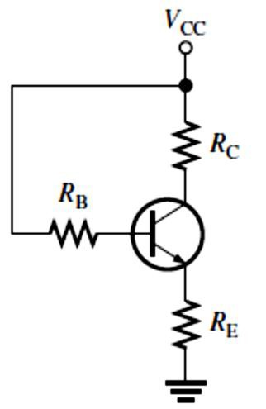
�CC ^{− �}BE
12 V − 0.7 V
^{𝐼}C(2) ^{= 𝛽}DC ⁽
𝑅
) = 200 ( ) = 6.84 mA
B
330 kΩ
�_{CE(2)} = �_{CC} − 𝐼_{C(2)}𝑅_{C} = 12 V − (6.84 mA)(560 Ω) = 8.17 V
The percent change in 𝐼_{C} as 𝛽_{DC} changes from 100 to 200 is
%∆𝐼_{C} = (
^{𝐼}C(2) ^{− 𝐼}C(1)
) 100% = (
6.84 mA − 3.42 mA
) 100% = 100% (an increase)
𝐼
C(1)
3.42 mA
The percent change in �_{CE} is
�CE(2) ^{− �}CE(1)
%∆�_{CE} = (
8.17 V − 10.1 V
𝑉
) 100% = ( ) 100% = −19.1% (a decrease)
CE(1)
10.1 V
As we can see, the Q-point is very dependent on 𝛽_{DC} in this circuit and therefore makes the base bias arrangement very unreliable. Consequently, base bias is not normally used if linear operation is required. However, it can be used in switching applications.
Emitter-Feedback Bias: combines base bias with the addition of an emitter resistor, as shown in Figure 5-14.
The idea is to help make base bias more predictable with negative feedback, which negates any attempted change in collector current with an opposing change in base voltage.
𝑰� = _{𝑹}
^{𝑽}�� ^{− 𝑽}��
Equation 5– 12
�
+ 𝑹⁄𝜷
� ��
FIGURE 5-14: Emitter-feedback bias.
EXAMPLE 5-9: The base-bias circuit from Example 5-8 is converted to emitter-feedback bias by the addition of a 1 kΩ emitter resistor. All other values are the same, and a transistor with a
𝛽_{DC} = 100 is used. Determine how much the Q-point will change if the first transistor is replaced with one having a 𝛽_{DC} = 200. Compare the results to those of the base-bias circuit.
Solution
For 𝛽_{DC} = 100,
^{𝐼}C(1) ^{= 𝐼}E ⁼ _{𝑅}
�CC ^{− �}BE
12 V − 0.7 V
⁼ 1 kΩ + 330 kΩ⁄100 ^{= 2.63 mA}
+ 𝑅⁄𝛽
E B DC
�_{CE(1)} = �_{CC} − 𝐼_{C(1)}(𝑅_{C} + 𝑅_{E}) = 12 V − (2.63 mA)(560 Ω + 1 kΩ) = 7.90 V
For 𝛽_{DC} = 200,

Slide 10
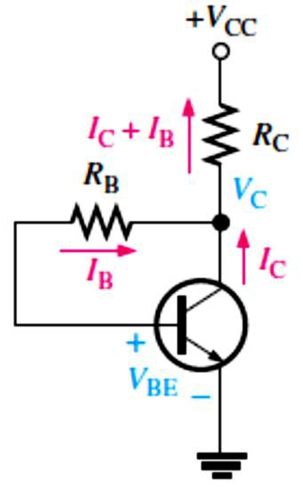
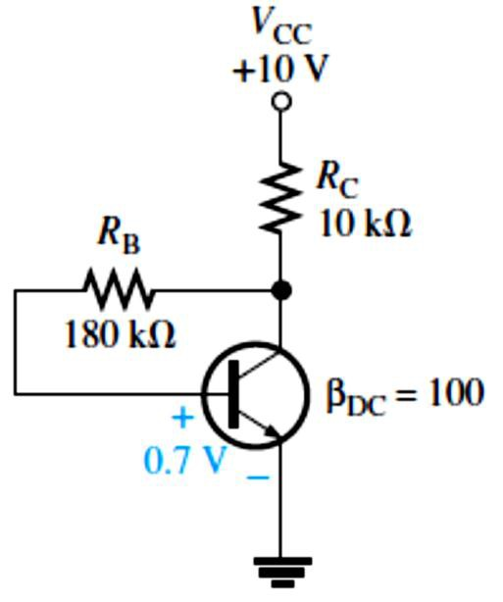
^{𝐼}C(2) ^{= 𝐼}E ⁼ _{𝑅}
�CC ^{− �}BE
12 V − 0.7 V
⁼ 1 kΩ + 330 kΩ⁄200 ^{= 4.26 mA}
+ 𝑅⁄𝛽
E B DC
�_{CE(2)} = �_{CC} − 𝐼_{C(2)}(𝑅_{C} + 𝑅_{E}) = 12 V − (4.26 mA)(560 Ω + 1 kΩ) = 5.35 V
The percent change in 𝐼_{C} is
%∆𝐼_{C} = (
^{𝐼}C(2) ^{− 𝐼}C(1)
4.26 mA − 2.63 mA
𝐼
) 100% = ( ) 100% = 62.0%
C(1)
2.63 mA
5.35 V − 7.90 V
%∆�_{CE} = (
�CE(2) ^{− �}CE(1)
) 100% = ( ) 100% = −32.3%
𝑉
CE(1)
7.90 V
Although the emitter-feedback bias significantly improved the stability of the bias for a change in 𝛽_{DC} compared to base bias, it still does not provide a reliable Q-point.
Collector-Feedback Bias: provides good stability using negative feedback from collector to base.
In Figure 5-15, the base resistor 𝑅_{B} is connected to the collector rather than to �_{CC}, as it was in the base bias arrangement discussed earlier.
𝑰� = _{𝑹}
^{𝑽}�� ^{− 𝑽}��
Equation 5– 13
�
+ 𝑹⁄𝜷
� ��
Since the emitter is ground, �_{CE} = �_{C} .
𝑽�� = 𝑽�� − 𝑰�𝑹�
Equation 5– 14
FIGURE 5-15: Collector-feedback bias.
EXAMPLE 5-10: Calculate the Q-point values (𝐼_{C} and �_{CE}) for the circuit in Figure 5-16.
FIGURE 5-16
Solution Using Equation 5–13, the collector current is
𝐼_{C} = _{𝑅}
�CC ^{− �}BE
10 V − 0.7 V
⁼ 10 kΩ + 180 kΩ⁄100 ^{= 788 𝜇A}
+ 𝑅⁄𝛽
C B DC
Using Equation 5–14, the collector-to-emitter voltage is
�CE
= �_{CC} − 𝐼_{C}𝑅_{C} = 10 V − (788 𝜇A)(10 kΩ) = 2.12 V
10

